Slide 1



XTensor 2024: 1st Workshop on Cross-stack Optimization of Tensor Methods Held in conjunction with ASPLOS'24
Organizers:
Lizhong Chen @ Oregon State Univ., Dong Li @ UC Merced, Frank Mueller @ NCSU, Jiajia Li @ NCSU
Time: 04/27/2024 1:30 – 5:30pm
Location: Grande E

Slide 2
Welcome
This workshop is to communicate state-of-the-art tensor methods in diverse communities, including but not limited to:
HPC, algorithms, runtime, compiler, architecture angles.
To fulfill the milestones of our NSF PPoSS project
“Collaborative Research: PPoSS: LARGE: Cross-layer Coordination and Optimization for Scalable and Sparse Tensor Networks (CROSS)” (Sep 15, 2023 – Aug 31, 2028)
Show our recent work to the community and to trigger more discussion.

Slide 3
Agenda
1:30 - 1:40 pm: Welcome and Opening Remarks
1:40 - 2:30 pm: Keynote Talk “What GPU tensor-cores really bring to the table?” by Ang Li @ PNNL
2:30 - 2:45 pm: A Novel Sparse Tensor Representation for Quantum Simulations, by Srikar Chundury @ NCSU
2:45 - 3:00 pm: Accelerating GEMV via Targeted Tensor Core Optimizations, by Sounder Rajendran @ NCSU
3:00 - 3:30 pm: Break
3:30 - 4:10 pm: Invited Talk “Toward Fast and Affordable Serving Systems for Large Language Models” by Xupeng Miao @ CMU
4:10 - 4:25 pm: Optimizing Sparse Tensor-times-Vector on Cerebras WSE-2, by Sai Krishna Teja Varma Manthena @ NCSU
4:30 - 5:30 pm: Panel & Open Discussion (Ang Li, Xupeng Miao)

Slide 4
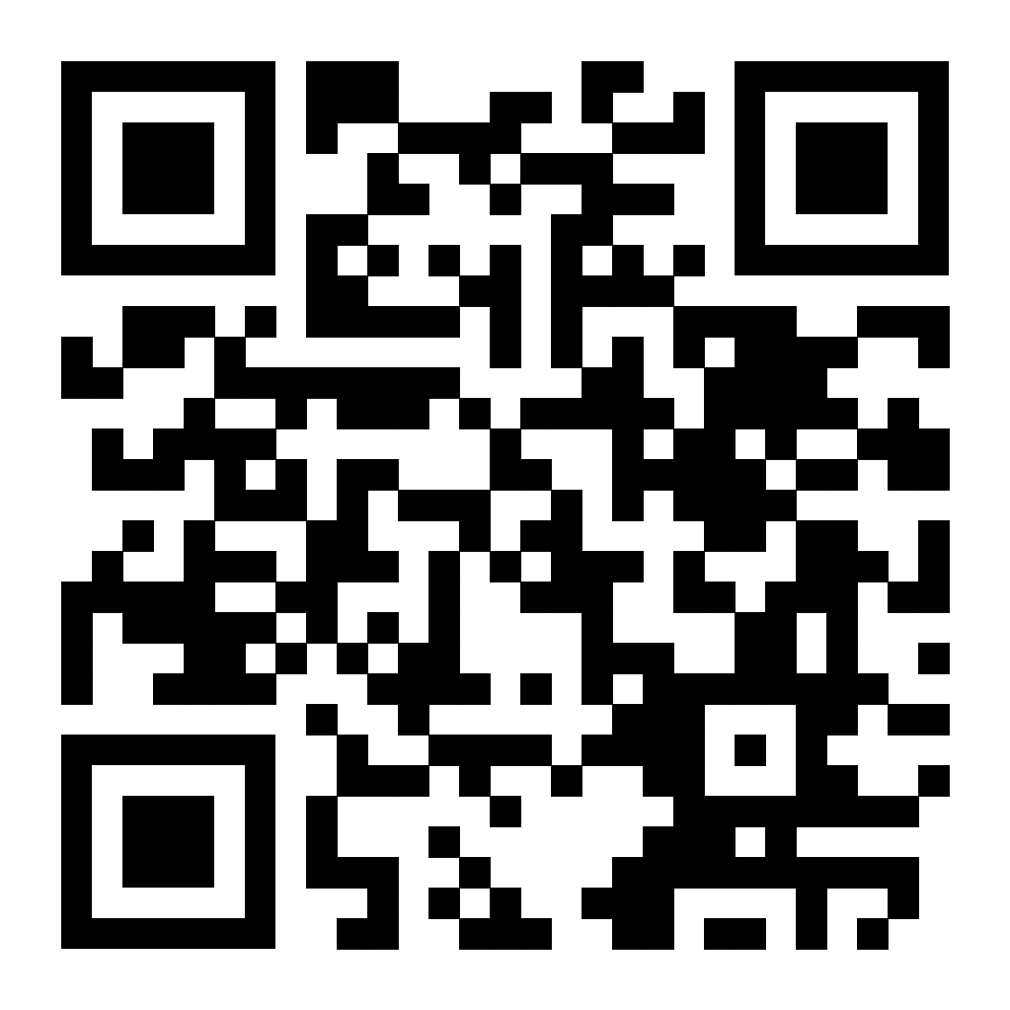
Workshop Website
Please find talk details on the workshop website:
Scan the QR code below
https://fruitfly1026.github.io/static/files/xtensor-asplos24.html
Or from ASPLOS’s main website: the workshop page.
Please let us know if you have any questions.
Email at the bottom of the workshop website.

Slide 5
Postdoc Position
NCSU has one postdoc position available, will be mentored by Dr. Frank Mueller and Dr. Jiajia Li.
Please ask us for more details if you are interested.
Contact: jiajia.li@ncsu.edu

